Slide 1
A Corporate Accounting and Reporting Standard
Training Curriculum
Notes:
Welcome to the trainings!
I’m Stephen Russell, a Senior Associate with the GHG Protocol team at WRI. I’ve been working exclusively on corporate GHG accounting issues for the past 7 years and I’m pleased that you have been able to join the trainings and look forward to working with you all over the next 3 days.
We’ll be covering a lot of material. At the end of each lesson there are scheduled general Qand A sessions, but I’ll also be stopping periodically throughout each lesson to see if the group has any questions. Also, please just feel free to post a question at any time. To ask a question, Joe:…..
There are a total of 8 modules or lessons in this webinar series. An before I start the trainings I’d like to first help set the context for the trainings by explaining what the GHGP is and how are various standards relate to one another.

Slide 2
What is the Greenhouse Gas Protocol?
Notes:
So, what is the GHG Protocol.

Slide 3


The Greenhouse Gas Protocol
The Greenhouse Gas Protocol was launched in 1998 by
Multi-stakeholder partnership of businesses, NGOs, governments and others
Notes:
The GHGP is a joint initiative between the WRI, Hqed in Washington Dc and the WBCSD, which is headquartered in Geneva. We were established in 1998, just over 15 years ago now. But we are much more than just an initiative between two NGOs – we fundamentally represent a partnership of businesses and stakeholders to develop and promote the use of consistent methods for GHG accounting and reporting. And That point is worth reiterating – our work is really stakeholder led to ensure our products meet needs in the marketplace.

Slide 4
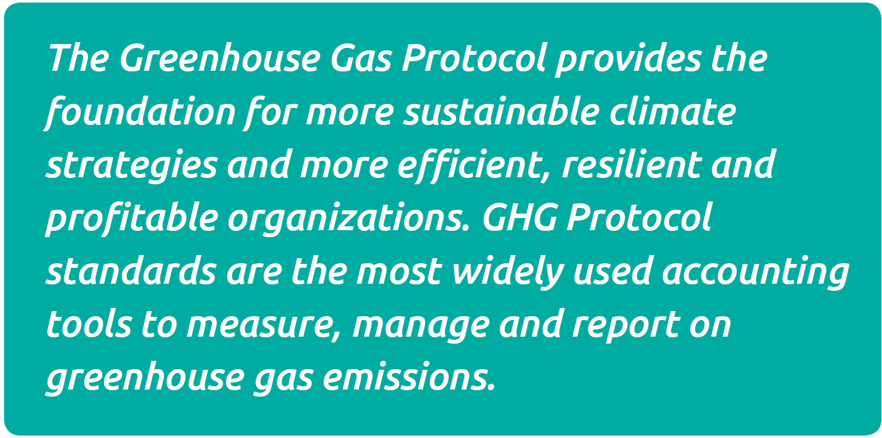
Our mission
Notes:
And our work serves a broader mission which is shown here. ………..

Slide 5
Our goals
  Simplify and reduce the burden of measurement and reporting
  Illuminate reduction opportunities and enable market based options
  Support management action and stakeholder reporting
  Enable credible, transparent and consistent information flow across multiple borders/jurisdictions
Notes:
The GHGP has 4 general objectives:
Simplify and reduce the burden of measurement and reporting
Illuminate reduction opportunities and enable market based options
Support management action and stakeholder reporting
Enable credible, transparent and consistent information flow across multiple borders/jurisdictions. For instance, between different companies or different units of a company.

Slide 6
GHG Protocol
Standards: 6 Major Standards + 7 Sector Standards
Tools: 25 +
Tool downloads: 1000 + per month
Newsletter subscribers: 9,500 +
Registered website users: 55,000 +
Programs based on GHGP: 50 + worldwide
Notes:
This slide provides some statistics on the GHG Protocol to give an idea of its breadth and impact.
To date we’ve published 4 major standards and xx sectoral supplements to those standards. I’ll provide an overview of those publications in just a minute.
We have developed over 25 tools for calculating the emissions from cross sectoral and sector-specific sources – and I’ll describe some of those tools in one of tomorrow’s lessons. These tools happen to be very extensively used – currently they are downloaded about xx times a month.
The GHG Protocol also produces a quarterly newsletter – that is available from our website and you can subscribe to it. Currently, the newsletter is sent to about xx subscribes.
And there are also many – over 50 in fact – programs based on the GHG Protocol. And I’ll also talk about those programs shortly.

Slide 7
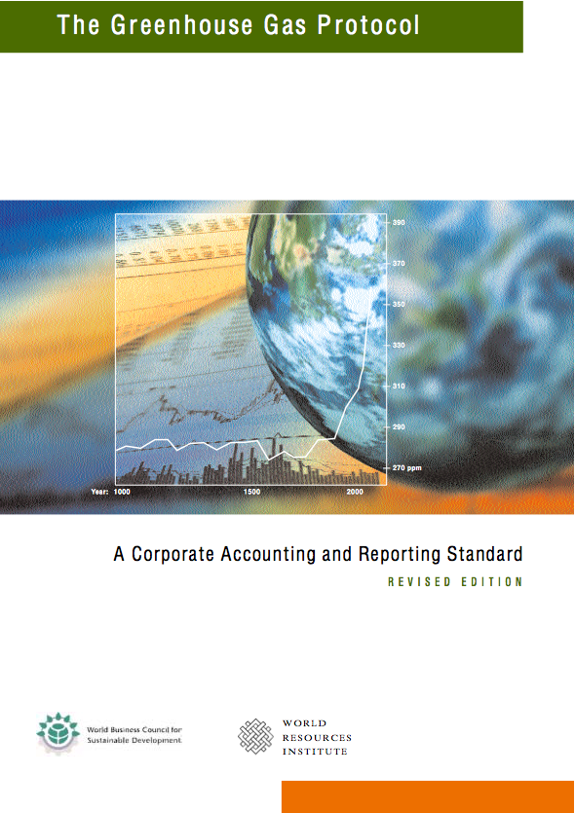
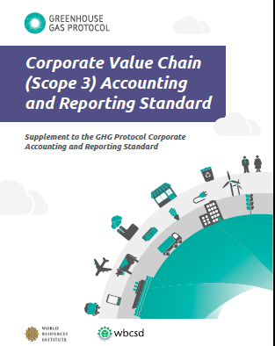
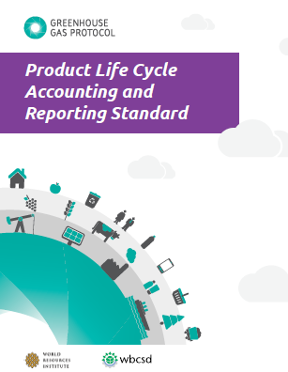

GHG Protocol flagship publications
Entity
Product
Project
Value Chain (scope 3) Standard
Corporate Standard
Project Protocol
Product
Notes:
As I mentioned, the GHG Protocol has published 4 standards on GHG accounting. These are Corporate Standard, The Value Chain or Scope 3 Standard, The Product Standard and the Project Protocol. Each of these standards basically define procedures for developing and reporting GHG inventories. More specifically, these standards are for the development of three different kinds of inventories: 1 is corporate or entity-level inventories, the second is product-level inventories, and the third is project level inventories.
I just want to spend the next few slides explaining these different types of inventories because it is important to distinguish what each of these different standards does, as well as understand how they map onto one another.

Slide 8
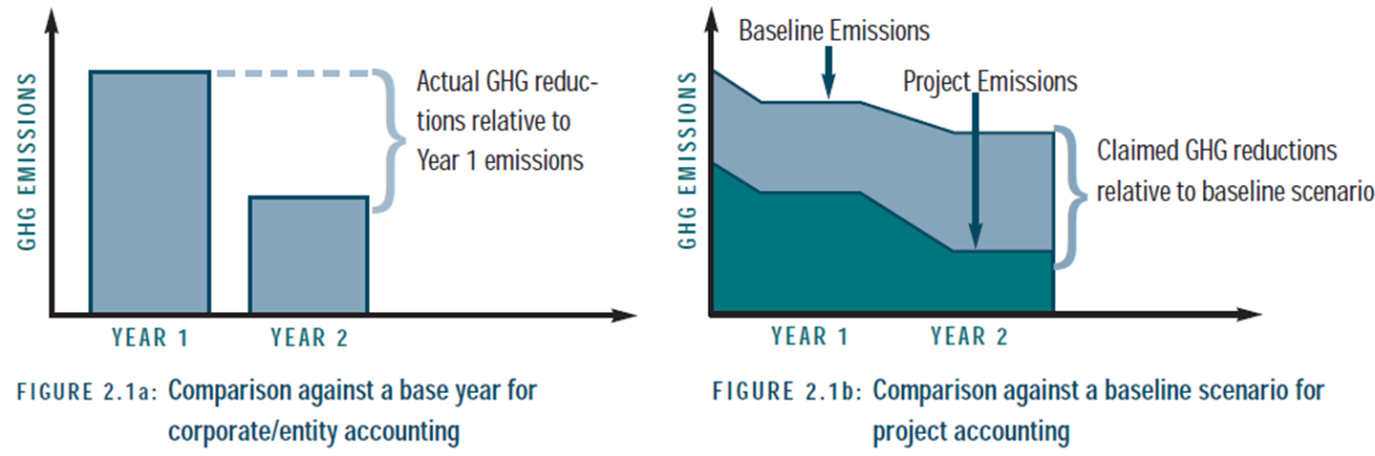
Three types of GHG accounting
1. Entity accounting
2. Project accounting
Combines emissions data from across an entity’s operations (emissions have mostly already occurred)
Emissions data compared with those of a prior base year
Quantifies emissions that will be avoided by a given project in the future
Impact estimated through a comparison with a baseline, “what if?” scenario
Notes:
First, corporate or entity-level inventories basically combine emissions data from across all of a company’s operations. These inventories contain information on historical emissions, so that they can be used to track reductions that have actually occurred compared to a prior year.
In contrast, in project-level accounting, we are concerned with quantifying the future emissions reductions expected from projects that have been established to reduce or avoid emissions, or to sequester carbon. Project-level accounting is used to quantify the imp[act of offset projects. Because we are looking at future impacts from projects in project-level accounting, the emissions reductions are estimated through a comparison with a hypothetical scenario or baseline scenario.

Slide 9
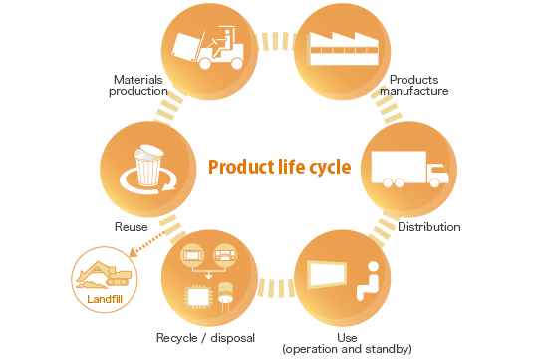
Three types of GHG accounting
3. Product accounting
Combines emissions data (past and future) from all phases of an individual product or service
Emissions data compared with those of a prior base year
Notes:
Finally, a product inventory combines all the emissions from the lifecycle of an individual product or service, regardless of whether those emissions have already occurred or will occur in the future. So, for instance, a product inventory will combine emissions from ………… Emissions reductions at the individual product level can be calculated by just comparing a product inventory with an inventory created for a prior year.

Slide 10
GHG Protocol flagship publications
Entity
Product
Project
Corporate Standard
Notes:
The focus of these trainings is on the Corp Std which is for the development of entity-level or corporate-level inventories.
A core concept in the Corporate Standard is that of direct and indirect emissions, and of scopes. …..

Slide 11
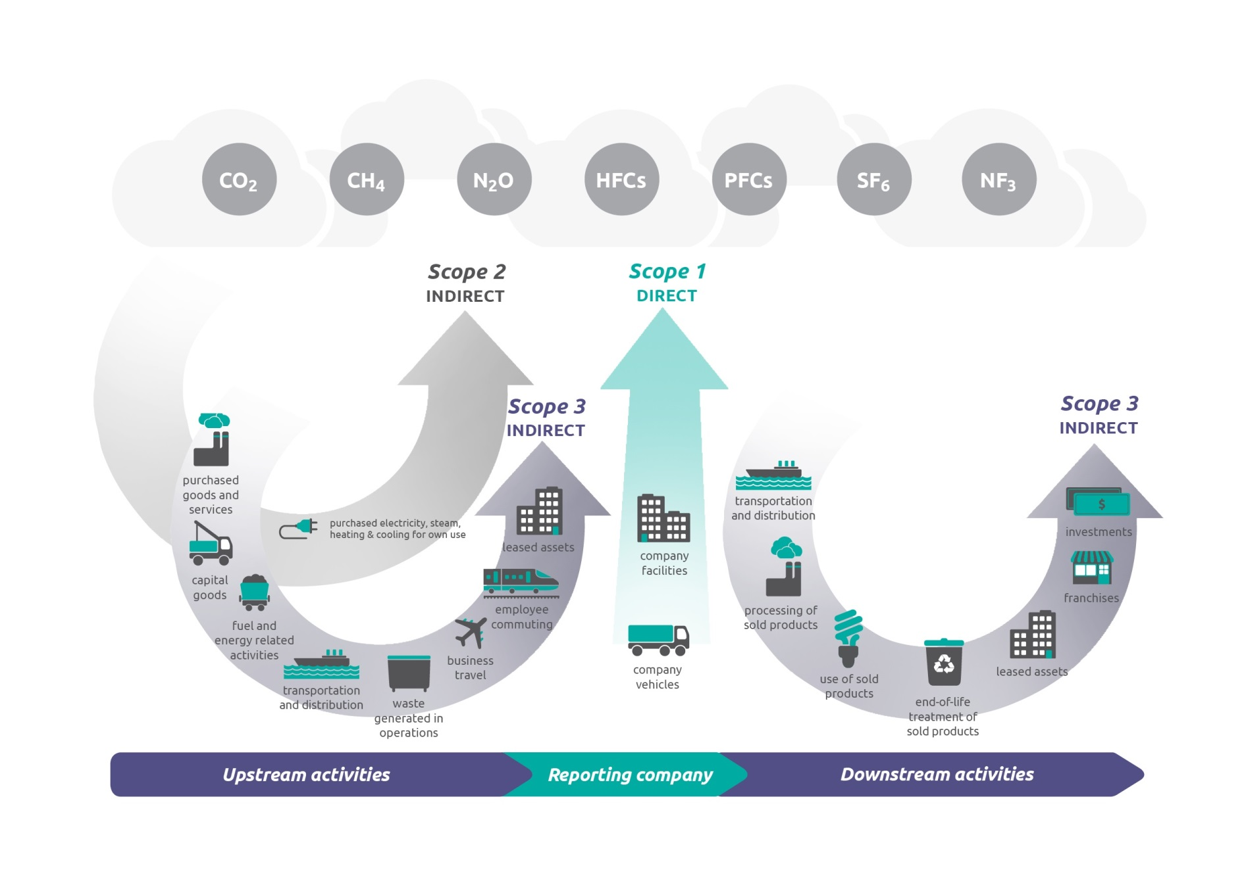
Scopes in corporate reporting
Notes:
This is a famous graphic and you will become quite familiar with it over the course of the next few days. Without getting into the weeds here, the basic point is that emission sources come in different categories based on whether they are internal to the reporting comnpany or exist upstream or downstream of the company along its value chain. Those that ate external are also called scope 3 emissions and need not be reported under the Corporat Standard.

Slide 12
GHG Protocol flagship publications
Entity
Product
Project
Value Chain (scope 3) Standard
Corporate Standard
Project Protocol
Product
Notes:
But Scope 3 emissions can be important – in fact they are often the largest source of emissions for companies. Because accounting for scope 3 emissions is inherently more complex – because it involves mapping value chains - - we have developed a separate Standard for accounting for and reporting scope 3 emissions. This stnadard is called the Value Chain or scope 3 standard, and it is very much complementary to the Scope 3 Standard. We’ll be discussing the scope 3 standards and the concept of scopes in a lot more detail later on today and tomorrow.
Our product lifecycle standard is specifically for the development of emisison invemtories for the life cycle of individual products and services and, finally, our Project Protocol is for quantifying the impact of individual GHG reductionprojects or offset projects.

Slide 13
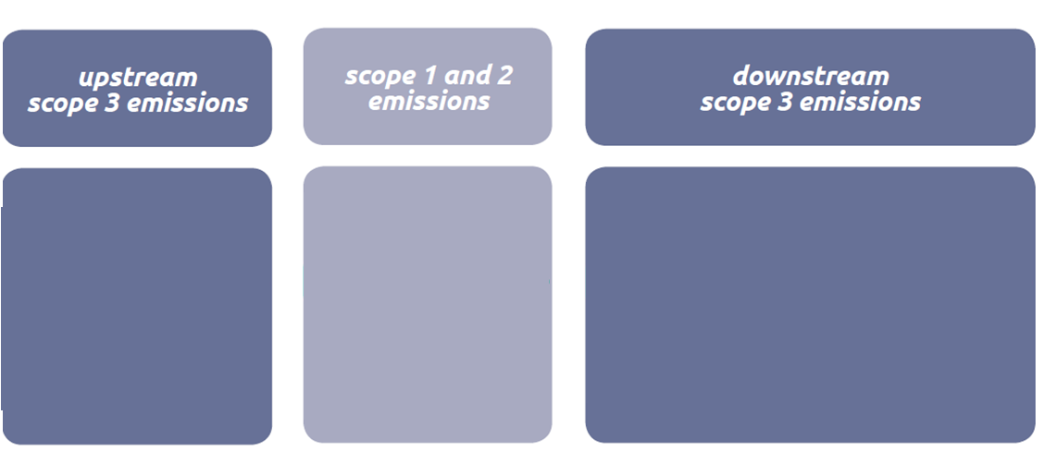
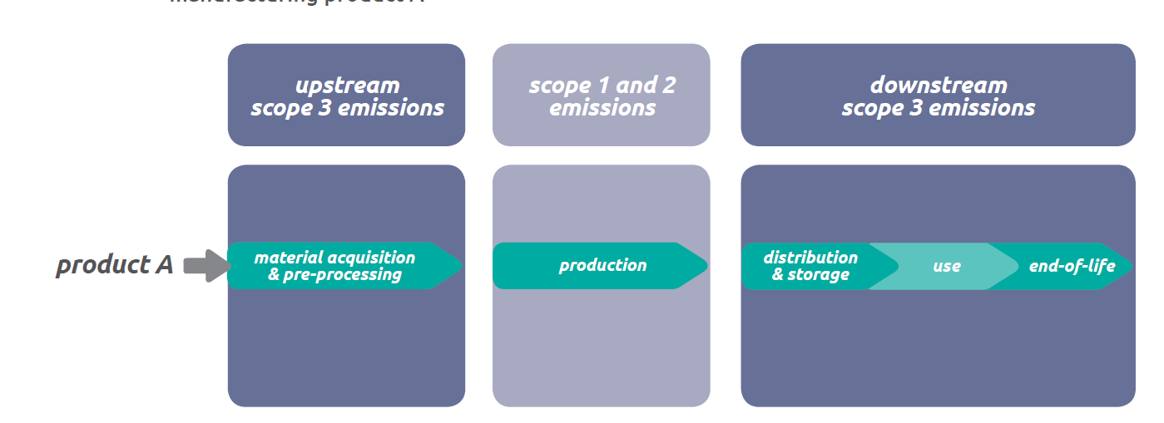
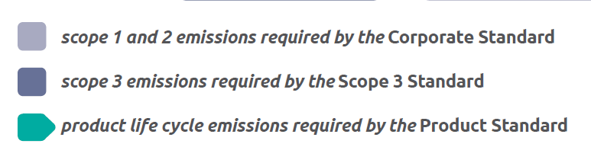
The standards are complimentary
Notes:
An important point is that these standards are complementrary, as shown in this graphic. Togethe the standards form a comprehensive framework for managing emissions.
- As I mentioned, The Corporate Standard covers internal emisisons sources, so-called scope 1 and scope 2 emissions.
- The Value Chain Standard covers the reporting of scope 3 emissions sources that are located upstream and downstream of the reporting company.
And a company’s combined scope 1,2 and 3 emissions is the same as the total amount of the life cycle emissions from each of that company’s products. So, for example, all of the emissions from the production of those products would equal a company’s scope 1 and 2 emissions.
Of all the available protocols – again -- we will be focusing on the Corporate Standard for this training. The Corporate Standard is probably the most fundamental standard for GHG accounting and will often be first adopted by companies before they start more sophisticated types of accounting such as product, value chain or project level accounting.
So, that is a fairly broad overview of the GHGP and its various products. We’ll be delving into some of the topics raised in these slides throughout the course. The next slides and the first lesson of the series will provide more background information on the Corp Std. But let me just pause for Qs.

Slide 14

Introduction
Lesson 1

Slide 15

Corporate Standard: Lesson Modules
Notes:
OK, this slide shows the 8 lessons in this training. Lesson 1 will be the overview of the Corp Std that I’ll give momentarily. The other lessons, lessons 2 – 7 review the main requirements in the Corporate Standard regarding how inventories should be prepared and publicly disclosed. The last lesson – lesson 8 _ will summarize of the material we will have covered in the preceding lessons. Again, these lessons will cover the key chapters in the Corp STd that contain requirements. There are other chapters in the Corp STd that contain only guidance and not requirements – I will just reference those other chapters in passing because I want to make sure that we fully understand the core material in the standard, which is the requirements.

Slide 16
Learning Objectives
In this lesson, you will learn:
How and why the GHG Protocol Corporate Standard was developed
What the Standard should (and should not) be used for
How a GHG inventory can bring value to a business
How the Standard interacts with GHG programs
Notes:
OK, so in lesson 1 you will learn…..

Slide 17
GHGP Corporate Standard
Provides standards and guidance for companies and other organizations to prepare GHG emissions inventories
Widespread adoption of standard:
  Several year, multi-stakeholder development process
  Robust, practical and built on practitioner expertise
Covers accounting and reporting of 7 GHGs:
  Carbon dioxide (CO2) Hydrofluorocarbons (HFCs)
  Methane (CH4) Perfluorocarbons (PFCs)
  Nitrous oxide (N2O) Sulphur hexafluoride (SF6)
  Nitrogen triflouride (NF₃)
Notes:
As I mentioned the Corp Std outlines requirements and guidance to help companies and other organizations develop corporate or entity level inventories.
It was Originally published 2001 and revised slightly in 2004. The first edition took 4 years to develop and involved the input of over 350 experts – I think that points to the importance of stakeholder processes that underpin the development of GHGP’s standards.
The Corp St is now Available in seven languages, including Portugiuese, Spanish, Mandarin, Japanese and Korean.
The Corp Std covers the accounting and reporting of 7 different GHGs or classes of GHGs. These gases are all regulated under the Kyoto Protocol. The std does not cover other gases that are GHGs, such as CFCs. This is because they are not covered yet by the KP and because, in the case of CFCs, they are covered by another UN protocol – the Montreal Protocol.
We’ll provide some statistics on the usage and adoption of the Corp Std in a few moments, but these statistics just serve to stress the fact that use of the Corp Std is very widespread. And we would atribute this fact to two key design elements: one is the development process, which involved a close collaboration amongst the GHGP and numersou stakeholders over a 4 year period. And the other element is that the std is robust, practical and built on practictioner expertise.

Slide 18
Objectives of the Standard
To help companies prepare a true, fair account of emissions
To simplify and reduce the costs of compiling an inventory
To assist businesses in managing and reducing emissions
To facilitate participation in GHG programs
To increase consistency and transparency in GHG accounting and reporting
Notes:
The Std was developed to serve 5 main objectives:
- To help companies prepare a true, fair account of emissions
- To simplify and reduce the costs of compiling an inventory. And one way in which the std does this is by basing some of its requirements on fincaily accounting practices, a point we’ll explore a bit later on.
- To assist businesses in managing and reducing emissions
- To facilitate participation in GHG programs
- To increase consistency and transparency in GHG accounting and reporting

Slide 19
Who should use this standard?
Businesses developing GHG inventories (primary users)
Other organizations developing inventories
  Non-governmental organizations (NGOs)
  Government agencies (consult Public Sector Protocol)
  Universities
Organizations designing voluntary GHG accounting and reporting programs
Policymakers or regulators designing GHG reporting rules
Notes:
In terms of who should use the standard, the main audience are businesses of course.
But the Std is also perfect;y suited for use by other orgs that develop inventories such as:..
The Std is intended also for organizations and policy makers that are designing GHG reporting requirements and reporting programs.

Slide 20
Sector Guidelines
Focus on sectors that
Present unique GHG accounting issues that are not adequately addressed in the parent Standard
Contribute significantly to global emissions
Offer significant potential for emissions reductions
Demonstrate strong demand for new guidance
Notes:
AS I mentioned earlier, we have developed a range of sector-specific guidelines to supplement the Corp Std. The Std was purposefully designed to offer a flexible and high-level framework that works across different sectors. And this design is one reason why the Corp Std in particular has seen such heavy adoption worldwide. But it also means that the CS does not necessarily address key accounting issues specific to individual sectors. And, to help companies in certain sectors interpret the use of the Corp Std, we have developed a number of sectoral guidelines.
T the focus of our sectoral guidelines is on:

Slide 21

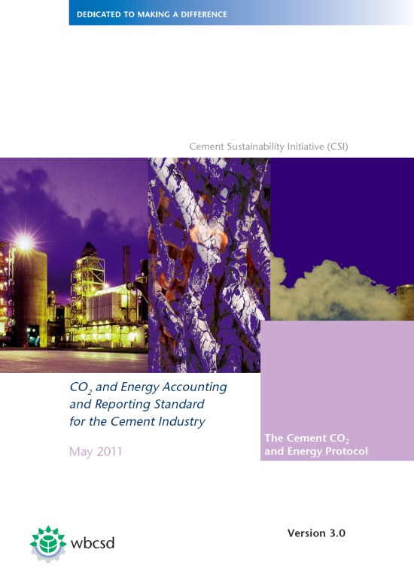
Sector Guidelines
Corporate Standard
Notes:
To date, we’ve developed guidelines for the cement sector, agricultural sector, power sector, the US public sector, amongst others.

Slide 22
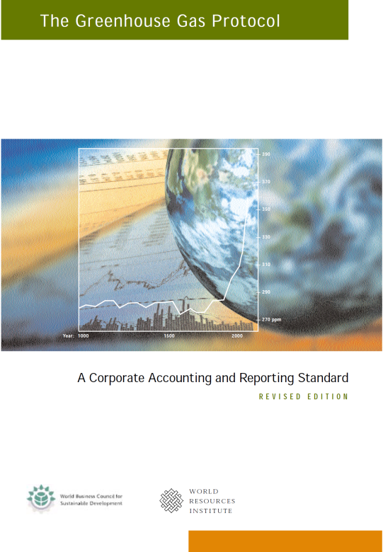
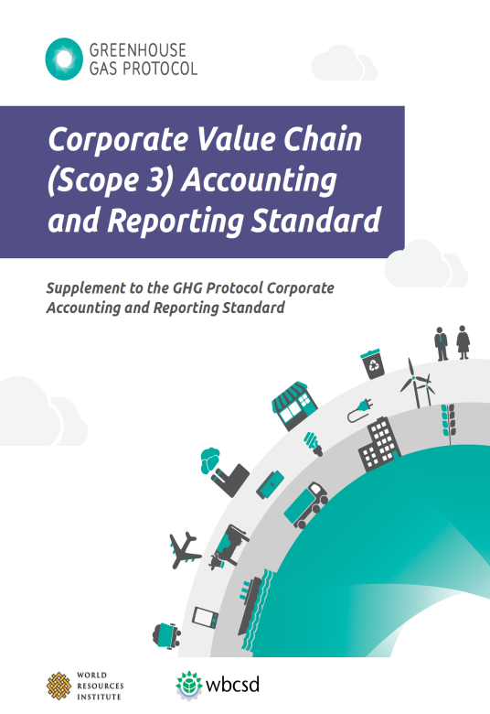
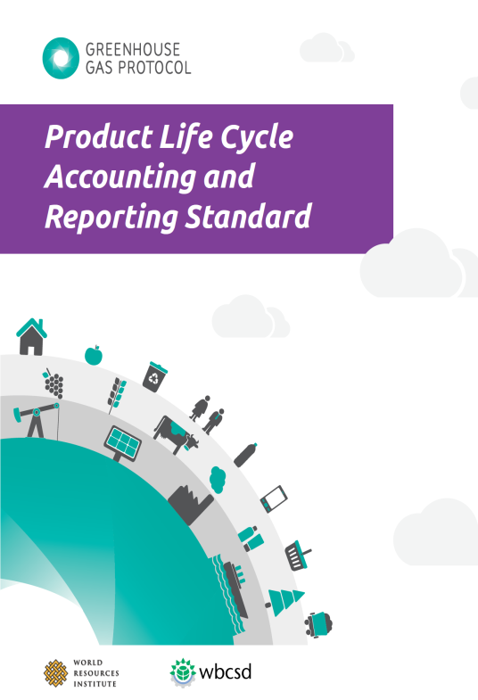
Focus of this training
Notes:
And just to make clear, the focus of this training is on the cross-sectoral requirement in the Corporate Standard. But I’d be happy to answer any questions you might have about our sector-specific guidelines.

Slide 23
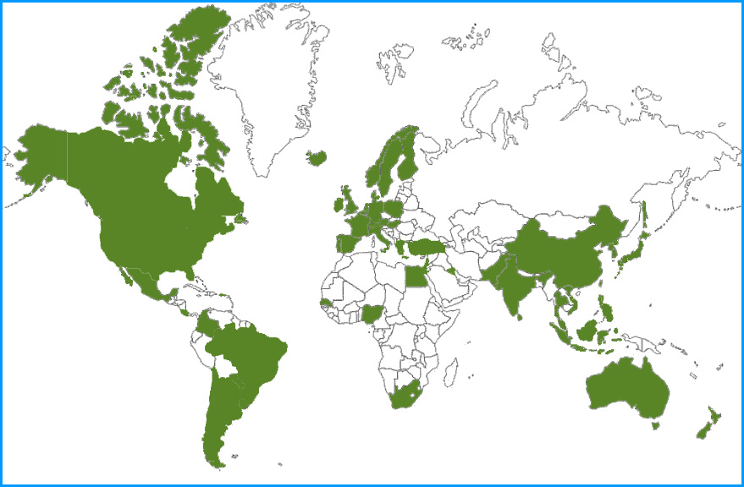
The Corporate Standard: Adoption
The Canadian GHG Challenge Registry
European Union GHG Emission Trading System (EU ETS)
US EO 13515
China iCET Climate and Energy Registry
US EPA Climate Leaders
Japan’s Voluntary Emissions Trading Scheme (JVETS)
The Climate Registry
South Korea’s GHG Emission Information System (GEIS)
Israel GHG Program
GHG Brazil Program
Australia GHG Challenge Plus Program
New Zealand CarboN Zero Programme
Notes:
There are now more than 50 GHG reporting programs worldwide based on the Corporate Standard and this slide shows only some of these programs. There are programs on every continent, including multiple programs in North and South America, Europe and Australasia. The point here is simply that the Corporate Standard has been very successful and forms the basis for virtually every GHG reporting program across the world.

Slide 24
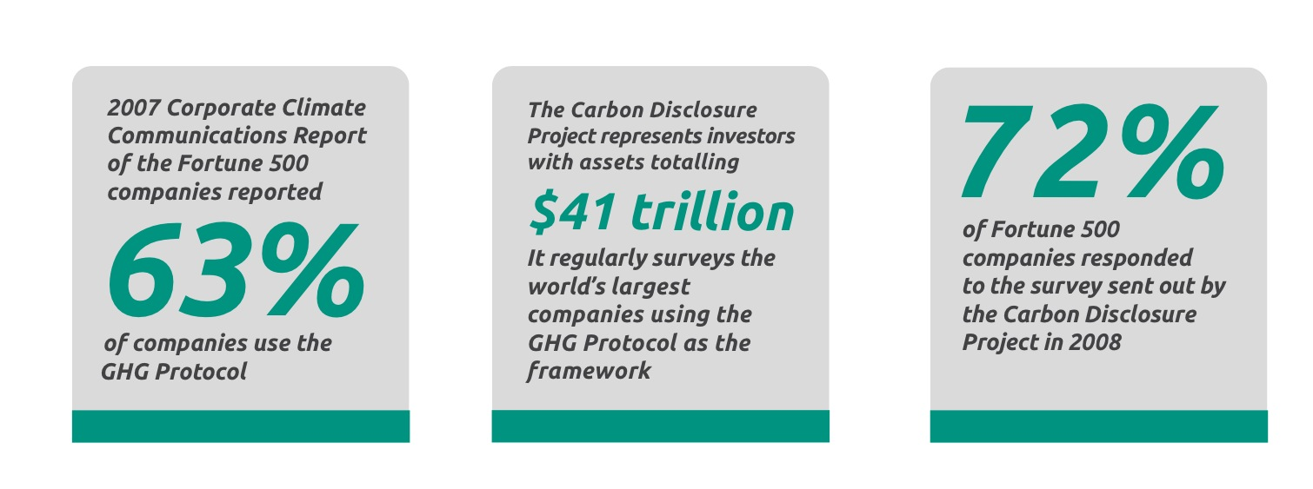
The de facto standard amongst businesses
GHG Protocol - Most important climate program after Kyoto Protocol (2010 GHG Workforce Survey)
Fast Company called WRI “the de facto authority on corporate sustainability reporting standards”.
Notes:
Many of the world’s largest companies are using the Corporate Standard. We don’t actively track the number of companies that use the Corp Std, simply because so many do. But to give an idea of usage at the corporate level, the CDP has released some helpful data. The CDP is a non-profit organization that represents investors with assets totalling $41 trillion worth. The CDP regularly surveys the world’s largest companies to assess investment-related risks and opportunities related to climate change. AN it turns out that over 80% 81% of companies in the Global 500 measure and report their GHG emissions to CDP.

Slide 25
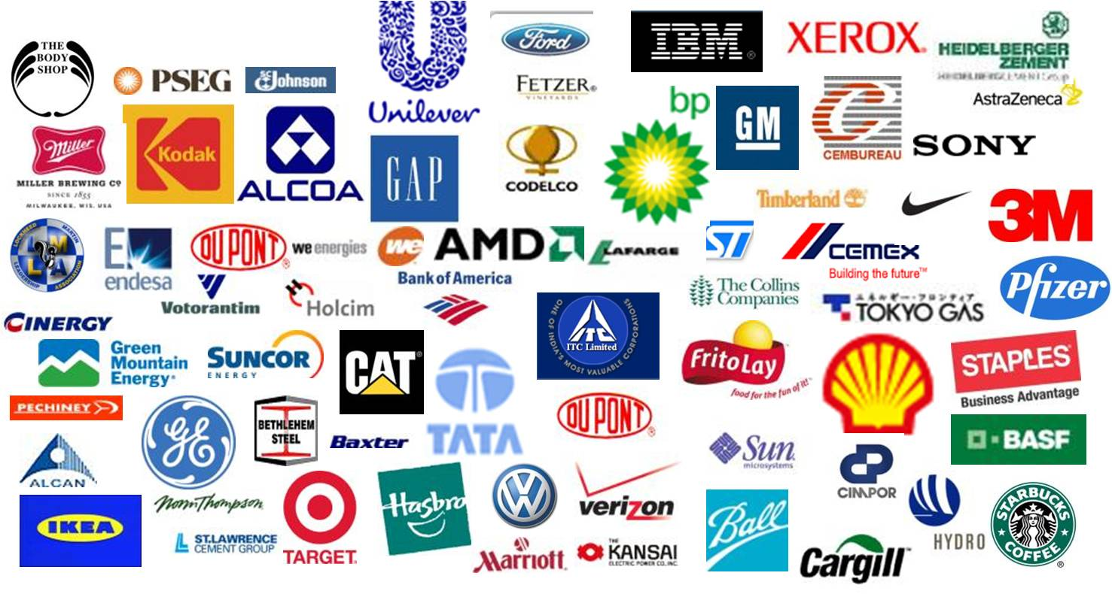
Reporting - Common practice in Leading Companies
GHGP adopted by 60%+ of Fortune 500 companies
Notes:
Some of these companies are shown here. So we see a wide range of sectors represented here, including oil and gas, chemicals, retail, metals, food and drink, banking, etc.

Slide 26
Business Value of a GHG Inventory
Management of GHG risks and identification of reduction opportunities
Public reporting and participation in voluntary GHG programs
Participation in mandatory GHG reporting programs and GHG markets
Recognition for early voluntary action
Notes:
The above reasons are given in the CS. We have found in our experience that companies also report because of the following:
Reduce impact on the global environment
As a first step in streamlining operations, which can lead to business benefits (e.g., cost savings through energy efficiency)
Meet consumer demand
Keep up with competition, increasingly common practice

Slide 27

Business goals for developing inventories
Business goal | Description
Understand operational risks and opportunities | Exposure to GHG regulations
 | Enhanced market opportunities (e.g., access niche markets)
 | Guide investment and procurement decisions
Track and reduce emissions | Identify emissions hot spots and reduction opportunities
 | Set GHG reduction targets
 | Measure and report GHG performance over time
 | Develop performance benchmarks and assess performance peers
GHG Protocol Agriculture Workshop – 04/05/2012
www.ghgprotocol.org
Notes:
SO, why are all these companies using the Standard? What kinds of business goals do companies have in mind when they set out to develop their inventories?
Well, there are many different business goals, but they can broadly be categorized into three types. In general, inventories can help companies understand…., such as….
Inventories can also help companies track and reduce emissions, because they help companies ..

Slide 28
Business goals for developing inventories
Business goal | Description
Report to stakeholders | Meet information needs of stakeholders
 | Participate in voluntary reporting programs
 | Report to government reporting programs
 | Improve corporate reputation and accountability
GHG Protocol Agriculture Workshop – 04/05/2012
www.ghgprotocol.org
Notes:
And also, inventoires help companies report to their stakeholders and be responsive to their customer base. For instance, inventories will help companies…..

Slide 29
Standard NOT for
Quantifying reductions from GHG mitigation projects (offsets)
  Consult the GHG Protocol guidance for Project Accounting
Accounting for life-cycle emissions from products
  Consult GHG Protocol Product Life Cycle Standard
Notes:
So, now that we have a better appreciation of what the Corp Std is designed to do, I think it would be helpful to reiterate what it does not do.
It is not intended for…….

Slide 30
GHG Protocol’s Relationship to other GHG Programs
Not a reporting program (does not collect inventories)
Does not require verification
Not designed for a particular program or policy
Foundation for, and compatible with, most programs
If participating in a GHG program, check its requirements
Notes:
I mentioned a range of GHG reporting programs that are based on the Corp Std. Virtually all programs are compatible with the Corp Std, but its worth making a few points here about our relationship with these programs.
The GHGP is not itself a reporting program: we do not collect inventories. And we also do not develop inventories for companies – instead there are many consulting companies that would fulfill that kind of role.
The GHGP does not require verification of inventories. A chapter in the CS would provide guidance on verification, but ind programs would have their own set of specific requirements about verification which vary according to the reasons the programs were established in the first place (e.g., vol versus mandatory reporting)
This last point I think touches on the broader issue of policy neutrality – the CS was not designed for a given policy or program. And that is to help ensure it is relevant to as many users as possible.
And, finally, if you are participating in a GHG program, it is definitely worth checking the requirements of that program because they may be more specific or add additional requirements onto those already in the Corp Std.

Slide 31
Summary
The Corporate Standard provides standards and guidance for preparing GHG emissions inventories
The Standard is primarily used by businesses; also used by other organizations and policymakers
Emissions inventories bring value to business
The Standard is compatible with many GHG programs and policies
Notes:
So, in summary…..

Slide 32
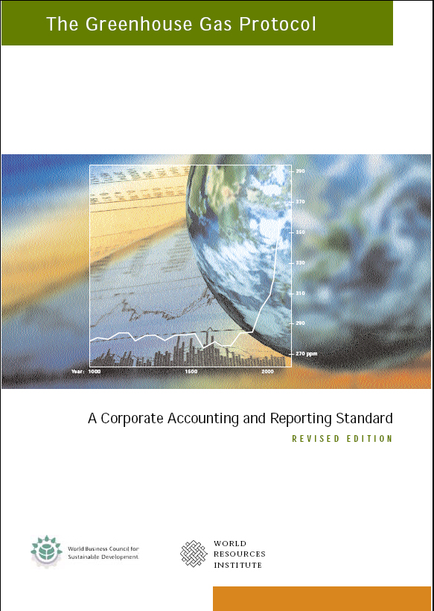
Further Reading
  The Greenhouse Gas Protocol: A Corporate Accounting & Reporting Standard
  Introduction

