Slide 1
A Corporate Accounting and Reporting Standard

Slide 2

Lesson Modules
Notes:
SO, we turn now to Lesson 7, which is on reporting GHG emissions.

Slide 3

Reporting GHG Emissions
Lesson 7

Slide 4
Learning Objectives
In this lesson you will learn:
Which information must reported in a GHG inventory
Which information may be reported optionally
Emission reporting tips
How to facilitate interpretation of emissions data
Notes:
In this lesson you will learn about 4 principal aspects of reporting inventories
-
-
Emission reporting tips for determining what types of information to report optionally in inventories
And using performance metrics to interpret emissions data.
We’ll go through each of these topics in turn but first let’s consider some GHGP reporting basics.

Slide 5
GHGP Report Basics
Relevant • Complete • Consistent • Transparent • Accurate
Base on best available data at time of publication
Acknowledge limitations
Communicate any identified past errors
Include company’s gross emissions separately from any GHG trades/offsets
Notes:
A credible GHG report presents information that is relevant, complete, consistent, accurate and transparent. While it takes time to develop a rigorous and complete corporate inventory of GHG emissions, knowledge will improve with experience in calculating and reporting data. The GHG P therefore recommends that a public GHG report:
• Be based on the best data available at the time of publication, while being transparent about its limitations
• Communicate any material discrepancies identified in previous years
• Include the company’s gross emissions for its chosen inventory boundary, separate from and independent of any GHG trades it might engage in.
By following the requirements and guidance we’ll be reviewing in this lesson, you should be able to produce inventories with the necessary detail and transparency for credible public reporting.

Slide 6
Report Information
Required
Optional
Company Description and
Inventory Boundary
Emissions and Performance Information
Emissions Information
Offsets Information
Scope 1
Scope 2
Scope 3
Notes:
At a basic level, an emission inventory contains two broad types of information.
First, there is the required information that is considered the minimum necessary to ensure the reported data are transparent and serve as a reliable basis for informed decision making.
Second, there is the optional information that companies can, if desired, include in its inventory to enhance its relevance and utility in decision making.

Slide 7
Required: Company and Boundary Info
Company description
Organizational boundary, consolidation approach
Operational boundaries
If scope 3 included, list activity types covered
Reporting period covered
Notes:
Let’s start off by reviewing the required information. In order for a ghg inventory to be in conformance with the Corp Std it has to include a number of descriptive elements on company and boundary info. This includes an outline of the organizational boundaries chosen by the company, including the consolidation approach used to set organizational boundaries. This just means companies should describe what business units are included in the inventory and whether they have used one of the control approaches or the equity share approach. Conpanies have also to provide an outline of the operational boundaries used, and if scope 3 is included, a list specifying which types of activities are covered. And, finALLY, The reporting period should also be described

Slide 8
Required: Emissions Data
Total Scope 1 and 2 emissions
Independent of any offsets, allowances, etc.
Emissions separated by Scope 1 and 2
Emissions of all 7 GHGs separately
In metric tonnes and in metric tonnes of CO2e
Ex: 100 t of CH4 2,100 t CO2e
CO₂ emissions from biomass separately from scopes
Base year and emissions profile over time
Context for any base year recalculations
Calculation methodologies
Any exclusions of sources or operations
Notes:
Inventories must obviously contain quantitative data on the emissions themselves, and the Corp Std outlines a series of requirements to ensure the credibility of these data.
First, the Total scope 1 and 2 emissions must be reported and independent of any GHG trades such as the sale, purchase, transfer, or banking of allowances or offsets.
The emissions data must be reported separately for each scope.
And emissions data must be provided for all seven GHGs; namely CO2, CH4, N2O, HFCs, PFCs, SF6 and NF3. Also these data must be provided in metric tonnes and in tonnes
of CO2 equivalent. So, for example, if a company emitted 100t of CH4 it would have to report this 100t figure along with the corresponding CO2e value obtained after the use of an appropriate GWP
As discussed in Lesson 4, the CO2 emissions from biomass must be reported separately from the scopes as a memo item. But, remember the CH4 and N2o emissions from biomass combustion are reported within the scopes.
Another requirement is to report the year chosen as the base year, and an emissions profile over time.
In lesson 5 we discussed tracking emissions over time and mentioned how base year inventories should be recalculated in certain circumstances, such as acquisitions/divestitures, outsourcing/insourcing, changes in reporting boundaries or calculation methodologies, etc. Because these recalculations can have a sig impact on the comparability of emissions data over time, the GHGp requires that companies also report the appropriate context for any changes that have triggered base year emissions recalculation
Another requirement is to report the methodologies used to calculate or measure emissions, as well as provide a reference or link to any calculation tools used.
• And finally, AS MENTIONED BEFORE, companies are required to report any specific exclusions of sources, facilities, and / or operations.

Slide 9
Required: If electricity product or supplier data
Report two scope 2 figures, one on market-based method and one on location-based method
If setting an emissions reduction goal, shall identify which method’s total is used
Disclose which method used in inventory total (if only reporting 1 total), and which used in base year
Ensure market-based emission factors meet the Scope 2 Quality Criteria
Notes:
The new scope 2 guidance introduces some new requirements. These really relate to when companies have electricity product or supplier data; in other words, when they have obtained a contractual instrument or certificate that conveys emissions information. In these case, the Corp Std and Scope 2 Guidance requires that companies use both the market-based and loaction-based methods to calculate their scope 2 emissions. That means companies end up with 2 emissions totals. Companies then have the choice of which scope 2 total to use when calculating the inventory total and setting a reudtcion target. And that’s fine; Companies can chose either result for these purposes, but the requirement is that companies report which figure has been used, to develop the inventory total or set a reduction target. A final requirement is that, when companies are using the market-based method for caluting scope 2 emissions, they ensure that whatever emission factors are used are consistent with certain quality criteria in the scope 2 guidance.

Slide 10
Recommended (for Scope 2 reporting):
Annual electricity consumption (in kWh, MWh, BTU, etc.)
Basis for upstream scope 3 calculations (which method used to determine upstream energy emissions in scope 3 category # 3)
Instrument features – i.e., instrument certification labels; power plant features such as technology type, age of facility, and facility location; and policy context characteristics such as if the facility received a subsidy and its relationship with supplier quotas
Notes:
While we’re on the topic of scope 2 emisison, the scope 2 guidance also makes certain disclosure recommendations.
Companies should report annual………
Basis for…. In other words….
And finally they should also report features of the contratual instruments that have been purchased and reflected in the scope 2 total using the market based method. There are a range of instrument features that are relevant here, but they could include aspects such as …..

Slide 11
Optional: Emissions and Performance Data
Scope 3 emissions
Emissions further disaggregated by facility, country, source or activity type)
Additional electricity generation emissions
Emissions from Non-Kyoto GHGs
Emissions performance benchmarking data
Ratio performance indicators
Outline of any GHG management programs or strategies
Notes:
Moving on to optional data, we recommend that public GHG inventories contain the following additional information when relevant:
- Emissions data from relevant scope 3 emissions activities for which reliable data can be obtained.
• Emissions data have to be reported by scope but they could be further subdivided by say business units or facilities, by country, or by source type such as stationary combustion versus process or fugitive emisisons, etc. Companies will obviously have to decide which particular subdivision makes most sense given their reporting objectives.
• Another optional item is the emissions attributable to a companies own generation of electricity that is then sold or transferred to another organization. These emissions will already be reported within scope 1 by the company producing the electricity, but sometimes companies find it useful to also report them as a memo item outside of the scopes when they generate a lot of elelectricity.
• We’ve discussed how the emissions of the 7 GHGs targeted by the Kyoto Protocol and UNFCCC should be reported in the scopes. Companies can optionally report the emissions of other GHGs, such as CFCs and Nox, as long as these gases are reported as a memo item.
- Continuing to move down the list, companies could also describe their performance measured against internal and external benchmarks, and as part of that performance assessment they could also report relevant ratio performance indicators, such as emissions per kilowatt-hour generated, tonne of material production, or sales, etc.
• Finally, and I appreciate this is a long list, companies could also provide an outline of any GHG management/reduction programs or strategies that they are undertaking.

Slide 12
Optional 2: Emissions and Performance Data
Any contractual provisions addressing GHG risks and obligations
Copy of any verification statement
Info on emissions changes not triggering base year recalculation
Emissions for all years between base year and reporting year
Info on inventory quality (e.g., uncertainties, policies to improve quality)
Info on any GHG sequestration
List of facilities included in inventory
Notes:
As YOU CAN IMAGINE, THERE ARE A WIDE VARIETY OF OPTIONAL REPORTING ELEMENTS THAT COMPANIes might decide to include in their inventories. I just want to highlight a few more on this slide.
• One element is information on any contractual provisions that address GHG-related risks and obligations.
• Another is an outline of any external assurance obtained for the inventory. This might include a copy of any verification statement.
- Companies could also report information on emissions changes that have not triggered base year recalculations;
Emissions for all years between the base year and the cuirrent reporting year
Information on inventory quality, such as details on uncertainties and policies to improve quality
In terms of C sequestration, the GHG Protocol does not provide methods for accounting for sequestration and simply states that companies can report information on C sequestration if they want to. However, that information should be reported outside of the scopes if it is reported.
- Finally, companies might also want to include a list of facilities reported in the inventory

Slide 13
Optional: Info on Offsets
Info on offsets purchased or developed outside inventory boundary
Disaggregate by GHG storage/removals and reduction projects
Specify if verified or approved by external program (e.g., CDM)
Info on reductions within inventory that have been sold as offsets
Specify if verified or approved by external program (e.g., CDM)
Notes:
I mentioned earlier that companies have to report their gross GHG emissions independent of any offset transactions. If any offset transactions have taken place, companies are encouraged to provide information on those transactions.
So, For instance, if offsets have been purchased or developed outside of the inventory boundary, companies should ….
Also, if companies have sold reductions that took place within their boundaries, they should specify if those reductions have been verified or approved by an external program such as CDM.

Slide 14
Reporting Tips
Report optional info based on objectives and audience
National or voluntary program requirements may differ
Difference between full public GHG reports and summary reports (sustainability/corporate social responsibility reports)
good practice to include link to full report in summary report
Facility data or ratio indicators may be kept confidential
Notes:
So, there is a lot of information that companies could optionally report in inventories. But how can companies know which optional information they should report?
In general, the appropriate amount of optional information can be determined based on the objectives and intended audience for the report.
Companies should be mindful that for national or voluntary GHG programs, reporting requirements may vary. For instance, a voluntary GHG program might require a verification statement or a list of all of the facilities included in the inventory.
Also, for public reporting, it is important to differentiate between a summary of a public report that is, for example, published on the Internet or in Sustainability/Corporate Social Responsibility reports, and a full public report that contains all the necessary data as specified by the Corporate Std. Not every circulated report must contain all the information as specified by this standard, but a link or reference needs to be made to a publicly available full report where all information is available.
Finally, for some companies, providing emissions data for specific GHGs or facilities/business units, or reporting ratio indicators, may compromise business confidentiality. If this is the case, these data need not be publicly disclosed, but can be made available to those auditing the GHG emissions data, assuming confidentiality is secured.

Slide 15
Interpreting Emissions
Car Company 1
Car Company 2
2009 Emissions:
2 million t CO₂e
2009 Emissions:
3 million t CO₂e
Which company emits more?
2009 Production:
200k cars
2009 Production:
500k cars

Slide 16
Ratio Indicators (optional)
Ratio Indicators: provide info on relative performance; emissions per business metric
Help to
Evaluate performance over time
Normalizing performance of different business units
Develop ratios that make sense for your company
Notes:
The last section of this talk will discuss the use of ratio indicators in interpreting emissions performance. The reporting of ratio indicators is optional, but they are extremely useful. Companies may choose to report GHG ratio indicators to accomplish a number of different goals, including:
• To Evaluate performance over time. For instance, ratio indicators can be used to relate figures from different years, identify trends in data, and show performance in relation to targets and base years
• And ratio indicators can be used to improve comparability between differently sized businesses and operations by normalizing figures;
Now, it is important to recognize that the inherent diversity of businesses and the circumstances of individual companies can result in misleading indicators. This is because apparently minor differences in processes, products, or locations can be significant in terms of environmental effects. Therefore, companies really have to know and understand the business context in order to be able to design and interpret ratio indicators correctly. For this same reason, the GHGP also recommends that companies provide some perspective in their reports on issues such as scale and limitations of indicators in a way that users understand the nature of the information provided.

Slide 17
Ratio Indicator Examples
Productivity or Efficiency Ratios:
value of business/GHG impact
ex: sales / tonne of GHG
$1 revenue / t CO₂e
Intensity Ratios:
GHG impact/unit of physical impact or
economic output
ex: ton of GHG / electricity produced
ex: tonne of GHG / sales
10 t CO2e / car
Percentages:
Ratio between items with same unit
ex: current emissions as % of base year emissions
30% lower emissions per car than in 2000
Notes:
In designing ratio indicators, companies should consider what ratio indicators best capture the benefits and impacts of their business; in other words, its operations, its products, and its effects on the marketplace and perhaps on the entire economy. Some examples of different ratio indicators are provided on this slide.
The first indicator is a PRODUCTIVITY or EFFICIENCY RAT I O , which expresses the value or achievement of a business divided by its GHG impact. Increasing efficiency ratios will therefore reflect a positive performance improvement. Examples of productivity or efficiency ratios include resource productivity, such as sales per tonne GHG, and process efficiency, such as production volume per tonne GHG.
The second indicator is an INTENSITY RAT I O , which expresses GHG impact per unit of physical activity or unit of economic output. A physical intensity ratio is suitable when aggregating or comparing across businesses that have similar products. In turn, an economic intensity ratio is suitable when aggregating or comparing across businesses that produce different products. In either case, a declining intensity ratio reflects a positive performance improvement. Examples of intensity ratios include tonnes of CO2 per electricity generated or per service or per sales.
The third type of ratio indicator is simply a percentage comparison between emissions in different time periods. An obvious example here is expressing the current year’s emissions as a percentage of base year GHG emissions.

Slide 18
Summary
Follow 5 GHGP principles when reporting
Required reporting: Scopes 1 and 2
Optional reporting: info on Scope 3, performance, offsets
If participating in a GHG program, check its reporting requirements
Interpreting emissions using ratio indicators
Notes:
So, in summary, we’ve covered a number of topics in this lesson. You should have learned:
How to follow the 5 GHGP principles when reporting
What information are required in an inventory; for instance all scope 1 and 2 emissions
What information can be optionally reported in an inventory, such as scope 3 emissions, and information on performance and offsets
You should also have learnt some basic tips in understanding what optional information might be most useful to report in an inventory, such as the requirements of a GHG reporting program
And, finally, you should have learnt how ratio in indicators are useful for interpreting emissions data.

Slide 19

Further Reading
The Greenhouse Gas Protocol: A Corporate Accounting & Reporting Standard
Chapter 9: Reporting GHG Emissions
The Greenhouse Gas Protocol: Scope 2 Guidance
Hot Climate, Cool Commerce: A Service Sector Guide to Greenhouse Gas Management
Part 3, Step 7: Reporting a Company’s GHG Inventory
ISO 14064-1
Section 7: Reporting of GHG Emissions

Slide 20
Inventory Tips

Slide 21
Complete a Master List of Facilities
Include owned and controlled
Facilities
Properties
Vehicle fleets
Etc.
Instrumental step in determining organizational boundaries

Slide 22
Determine How Data Will be Collected
Points to consider:
Should the company use a centralized or decentralized approach?
Who manages the data collection within the relevant departments?
Is a third party used to manage electricity purchases and use?

Slide 23
Centralize Data Collection Process
Data should be sorted into a centralized location
The processing technology must first be determined
Excel Batch-loading is helpful
Excel is acceptable for smaller companies
Optimal system: allows for analysis and communication of results.

Slide 24
Develop Data Collection Survey
Important for decentralized data
Keep facility managers in the loop
Web-based survey optimal if internet access available
Survey should collect the activity data
Activity data should be converted to emissions

Slide 25
Develop Quality Assurance Standards
Automated
software identifies outliers in data
Recommendations
common places where people make errors
Notes:
These would be procedures to help reduce error in the inventory. It can be automated, where the software identifies data that is likely inaccurate based on its size, or recommendation based, where the preparer is warned of common mistakes made on inventories.

Slide 26
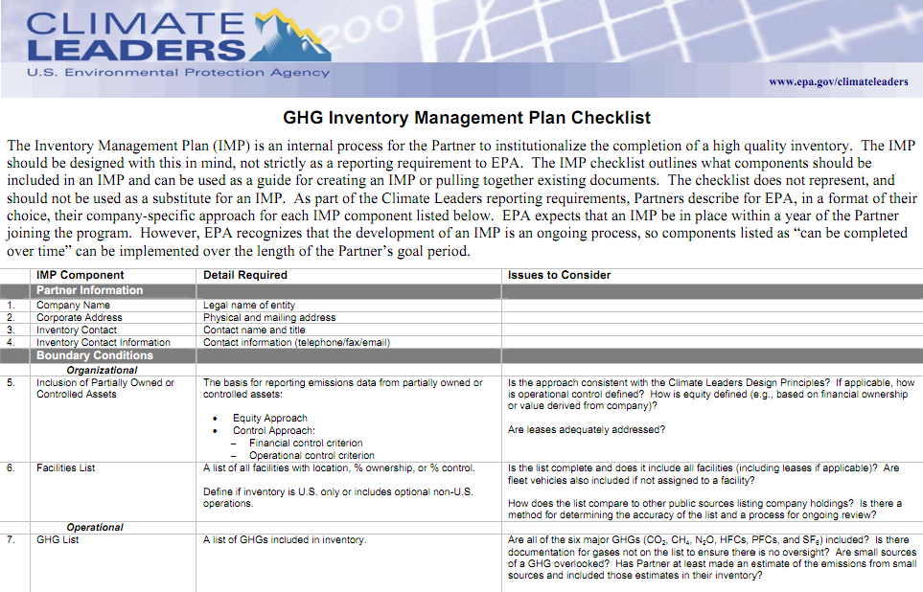
Develop an Inventory Management Plan
Document the inventory process
Document the QA/QC process
See Climate Leaders checklist for reference
Notes:
http://www.epa.gov/climateleaders/documents/imp-checklist.pdf

Slide 27


Incorporate Business Goals into Reporting
Photo from flickr/jonas_k
Notes:
The method by which a company reports its inventory depends on the desired outcomes. They may chose to report to a registry (like The Climate Registry or the Carbon Disclosure Project) if they want to gain public recognition or if the government requires it, add it in an annual report or sustainability report for shareholders, or get certified to communicate environmental efforts to consumers.

