Slide 1
A Corporate Accounting And Reporting Standard
Training Curriculum

Slide 2

Lesson Modules
Notes:
OK. Welcome back. Let~s turn now to the final lesson of this training. This lesson will provide a concise review of the main topics we have encoutered over the last 3 days.

Slide 3

Review
Lesson 8

Slide 4

The GHGP Corporate Standard
Provides standards and guidance for preparing GHG emissions inventories
Primarily used by businesses; also used by other organizations and policymakers
Policy neutral, although used by and compatible with many GHG programs
Emissions inventories bring value to business
Notes:
The GHGP Corporate Standard was originally published 2001. A revised edition followed in 2004. The Standard took 4 years to develop, involving the input of over 350 experts.
It is now available in seven languages, inc Japanese, Spanish, Mandarin, Portuguese and other languages.
The Corp Std was developed with sevreal objectives in mind, including to simplify and lower the costs of developing an inventory; to harmonize ghg reporting practices around a set of generally accepted best practices; to provide information that can serve as the basis for effective mitigation strategies; and to facilitate reporting to a wide range of stakeholders, including internal management and external stakeholders.
The corporate Standard is now the de-facto standard amongst businesses. For instance, Easily over 60% of Fortune 500 companies use the Corporate Standard, as do over 70% of companies responding to the CDP. In fact the numbers are probably higher as many companies would use reporting specifications that are based on the Corp Std. So businesses are the primary users, but it is also used by other organizations developing inventories, such as non-governmental organizations (NGOs), Government agencies, and Universities, etc.
The standard is explicitly designed to be policy neutral, so it is also used by policy makers and by organizations designing voluntary GHG accounting and reporting programs. In fact the standard forms the accounting basis for virtually every ghg reporting program in the world, including…..

Slide 5
GHG Accounting and Reporting Principles
To ensure that your inventory represents a faithful, true and fair account of your company’s emissions, adhere to the GHG accounting and reporting principles:
RELEVANCE
COMPLETENESS
CONSISTENCY
TRANSPARENCY
ACCURACY
Notes:
All of GHGP’s publications are designed with 5 overarching principles in mind. These principles are also intended to help users apply our publications and ensure that GHG inventories represent a faithful, true and fair account of a company’s emissions. These principles are derived largely from financial accounting and reporting principles. I’m just going to spend a few moments on each principle because they are fundamentally important.
Relevance: GHG inventories must contain information that internal and external users need for decision making. What this means is simply that inventories should be designed to reflect
Company characteristics
Stakeholder needs
Organizational structures
Business context and relationships
The second principle is that companies should make a good faith effort to provide a complete accounting of their emissions. In other words, companies should account for all emissions within their chosen inventory boundary and, If some emissions estimated insufficiently, document and justify these instances.
Consistency: Consistency is important because comparable data are needed to track emissions performance over time. In order for inventory practices to be consistent, companies have to:
Consistently apply inventory boundaries and calculation methodologies
And document and justify any changes to these
The fourth principle is is transparency. Emissions data must be disclosed in clear and factual manner to allow users to confidently interpret the data.
And the fifth principle is accuracy – This means that data should be credible enough to use in decision making and that uncertainties should be reduced as far as is possible.
Again these principles should underpin the design of inventories.

Slide 6



Organizational Boundaries
Determine which parts of the company are included in the inventory, and at what percentage
Total emissions accounted can vary significantly
depending on consolidation approach
Companies can use both approaches to get a more thorough assessment of their emissions
1. Equity Share
2. Control
a) Financial control
b) Operational Control
100%
30%
100%
Notes:
There are three main accounting steps in designing an inventory – setting organizational boundaries, setting operational boundaries and setting base years. And what I’ll do now is spend a few slides on each step to recap some of the most important points in implementing these steps.
The first step is to set organizational boundaries, which determine which operations are owned or controlled by the entity and which therefore should be included in the inventory. Organizational boundaries are important because of the complex structure of many organizations. For example, many organizations consist of subsidiaries, joint ventures, or franchises, and organizational boundaries establish a consistent method for accounting for the emissions from all parts of an entity. Note that generally the more complex the corporate structure, the more important organizational boundaries become. Conversely, in organizations with a very simple corporate structure, the manner in which organizational boundaries are chosen may have little effect on the estimated total emissions from that organization. However, regardless of corporate complexity, organizational boundaries must always be set.
As you have seen, the total emissions accounted for by a company can vary significantly
depending on consolidation approach chosen. For this reason, companies can use more than one approach to get a more thorough assessment of their emissions

Slide 7
Summary of Organizational Boundary Approaches
APPROACH | DEFINITION | GHG ACCOUNTING
Equity share
Financial control
Operational control
Percent ownership
% owned
Directs financial policies to gain economic benefits
If yes: 100%
If no: 0%
If joint: % owned
Authority to introduce and implement operating policies
If yes: 100%
If no: 0%
Notes:
So, what approaches can be used? The Corporate Standard defines two general approaches :
(1) The first is the Equity Share approach. Using the equity share approach organizations account for emissions according to the equity share the entity holds in the operation. Example: If an entity owns 40% of an operation, it must account for 40% of the GHG emissions from that operation, regardless of who “controls” the operations. The equity share reflects economic interest, which is the extent of rights an organization has to the risks and rewards in an operation and which is typically aligned with the organization’s percentage ownership of that operation.
(2)The second general approach is based on control, and under the control approach an organization accounts for 100% of the emissions from operations over which it has “control”. Now, control can be defined in one of two ways:
One is Financial control, and an entity exerts financial control over an operation if the entity has the ability to direct the financial and operational policies of the operation with the goal of gaining economic benefits. To determine whether or not an organization exerts financial control one can consider its Corporate voting rights and financial reports….. So, for example, if a business unit is treated as a group company or subsidiary in the parent company’s financial reports, then the parent company is considered to have financial control.
The second control approach is Operational control, which exists when an entity, or one of its subsidiaries, has the full authority to introduce and implement operating policies at the operation….. Note that having operational control does not necessarily mean that an entity has authority to make all decisions concerning an operation. For example, large capital investments may require the approval of all the partners having joint financial control. Having operational control just means that an entity has the authority to introduce and implement its operating policies.

Slide 8
Operational Boundaries
Operational boundaries determine which emissions are included and how they are classified
Apply selected consolidation approach to leased assets, outsourced activities or franchises
Scope prevent emissions from being double-counted
Scope | Type of Emissions | Reporting
 | direct | mandatory
 | purchased electricity | mandatory
 | all other indirect | optional
Scope 1
Scope 2
Scope 3
Notes:
The second crucial step in designing an inventory is setting operational boundaries, which classify emissions sources by whether or not they are controlled and/or owned by the reporting company or by a third party, and therefore whether they should be included in an inventory. Setting operational boundaries is useful because they help reduce the risk of double counting emissions; they provide more useful information to stakeholders; and they allow for the more effective management of the GHG risks and opportunities along corporate value chains.
Now, as we~ve seen, Setting operational boundaries involves identifying whether or not a source is direct or indirect, and whether it belongs to one of three scopes.
Direct sources are owned or controlled by the reporting company. All direct sources are further classified as scope 1.
Indirect sources, in turn, are owned or controlled by a third party, but their emissions are nonetheless influenced by the reporting company. Indirect sources are either scope 2 or scope 3: Scope 2 emissions stem from the generation of electricity that is purchased by the reporting company, while scope 3 emissions are all other indirect emissions.
Scope 3 are optional in the Corporate Standard and scope 1 and 2 emissions must be reported in an inventory.
Operational boundaries build on organizational boundaries, so the org boundary approach must be considered when drawing the operational boundaries for, for example, leased assets, outsources activities or franchises.

Slide 9
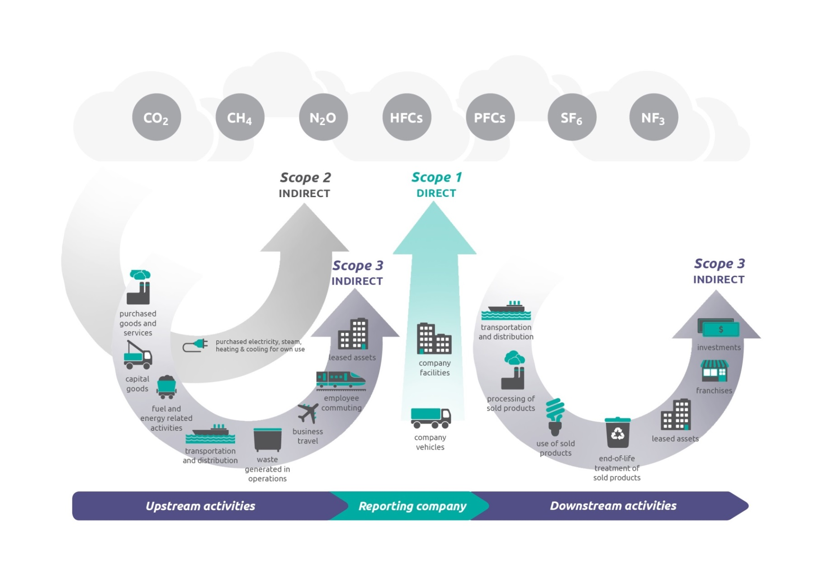
Scopes 1, 2 and 3
Account for and report emissions from each scope separately
Notes:
This slide summarizes the concept of scopes. Here we see that scope 3 sources can exist upstream and downstream of a company. In fact, 15 distinct categories of scope 3 sources exist, and companies may want to focus on accounting for and reporting those activities that are most relevant to their business and goals, and for which they have reliable information. Again, since scope 3 emissions are optional, scope 3 may not lend itself well to comparisons across companies.
As this figure also shows, only the emissions of these 6 gases, plus NF3, should be reported in corporate inventories. And the emissions belonging to each scope should be reported separately. Any emissions of GHGs other than these 7 should be reported outside of the scopes as a memo item. This includes the emissions of CO2 from biomass and it also include the sequestration of C in soils and biomass.

Slide 10

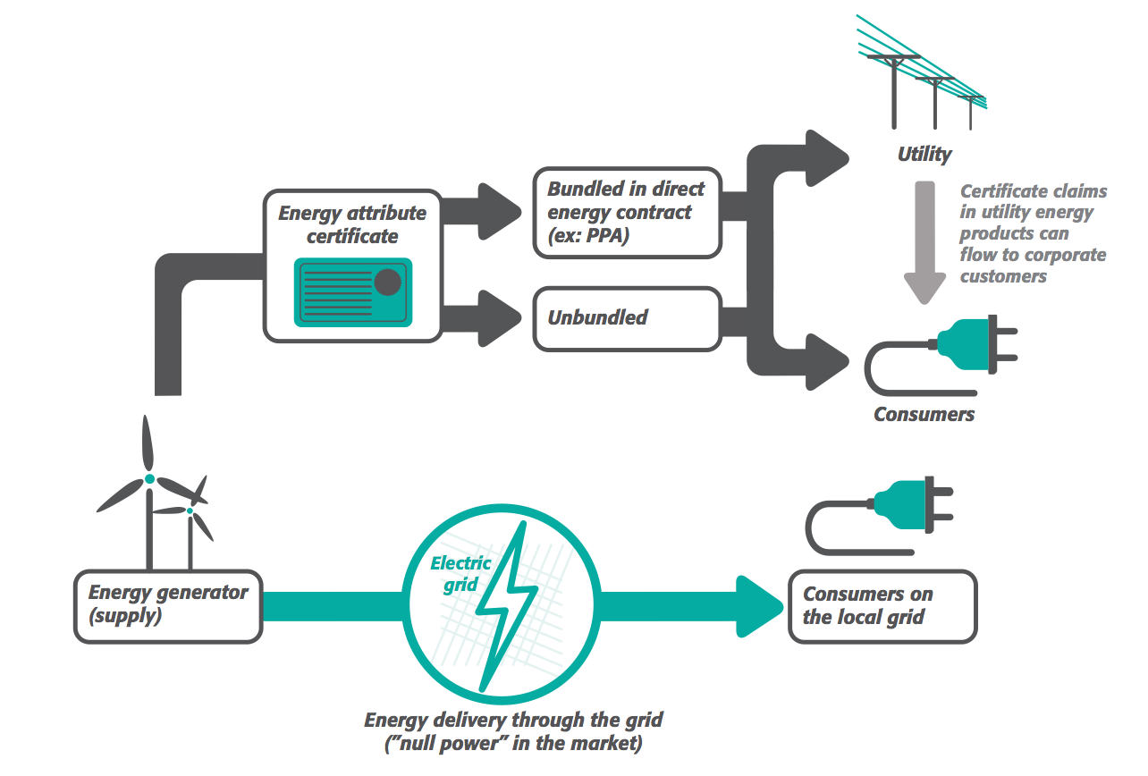
Notes:
The new Scope 2 Guidance introduces some important new requirements, including:
Dual reporting requirement
Market-based method instruments need to meet Scope 2 Quality Criteria
Recommended additional disclosures to give background and help distinguish your power purchase.

Slide 11
Tracking Emissions Over Time
did NOT exist
20
Base year: the year in history against which an organization’s emissions are tracked over time
Define your organization’s recalculation policy
  Define significance threshold to trigger base year recalculation
Recalculate for
  structural changes
  changes in calculation methodology
  discovery of significant errors
Don’t recalculate for
  organic growth or decline
  changes involving facilities that didn’t exist in base year
  out-/in-sourcing of activities previously under a different Scope
15
20
30
30
Emissions
25
30
30
25
1
Base Year
2
Increase in production
3
Company acquires unit C
Notes:
The third crucial step in designing an inventory is setting a base year. A base year is the year in history against which a company’s emissions are tracked over time. Normally the first year for which verifiable data are available
Base years are important because they help companies track progress toward reduction targets and they also help companies put structural changes into context.
An important aspect of base year emissions is that they should be recalculated to ensure consistent inventory data and boundaries over time and to ensure that base years remain useful as a basis for tracking performance. The Corp Std requires companies to develop a base year emissions recalculation policy and apply it in a consistent manner over time. This policy should define a significant threshold that triggers base year recalculations.
So, what factors would cause recalculation? Well, base years have to recalculated when:
Significant changes occur in the structure of the organization, such as the purchase/divestment of operations that existed in base year. While a single structural change might not have a sig impact on the base period, the cumulative impact of multiple changes might be significant, and that’s something companies should be mindful of
Significant changes occur in calculation methods or upon the discovery of significant errors in the inventory process.
On the other hand base periods do not have to be recalculated when …
The company just experiences organic growth or decline, rather than a structural change. And by organic growth I mean increases or decreases in production output and closures/opening of operating units that are owned by the reporting company.
Also, if the company acquires operations that did not exist in the base period, then that does not trigger base period recalculations.
And, recalculations are not needed if the out-/in-sourcing of activities has occurred where those activities were previously reported under a different Scope

Slide 12
Identifying and Calculating Emissions
Identify Sources
stationary, mobile, process, fugitive
Select Calculation Approach
direct measurement, stoichiometry, estimate emissions
Collect Data and Choose Emissions Factors
Activity data
x
Emission factor
=
t of emissions
t of emissions
x
GWP
=
CO₂e of emissions
Apply Calculation Tools
http://www.ghgprotocol.org/calculation-tools
Roll-up Data to Corporate Level
report activity data and emissions estimates to corporate
Notes:
Once these basic elements of inventory design are in place, a company can then proceed to calculate its emissions. The quantification process involved 5 key steps:
The first is identifying emissions sources, which generally belong to four categories.
Stat combustion sources which combust fuel in stat sources such as boilers and heaters
Mobile combustion sources are simply transportation vehicles or mobile machinery
Process sources are physical or chemical processes that emit GHGs. They include things like cement calcination, aluminum smelting, etc
And the last category is of fugitive sources. These are unintentional releases of GHGs from, for example, coal mines.
The second step is to select a calculation approach. Different types of approaches exist, including:
Direct measurement which involves the monitoring of actual levels of GHG concentration and flow rates from a stack. Directly measuring GHG emissions is not common and is generally limited to stationary combustion sources. GHG emissions are more often derived from a calculation-based approach, using either a stoichiometric basis or, more commonly, documented emission factors.
When using Efs, companies calculate emissions by multiply activity data by an emission factor and then multiplying by an appropriate GWP value.
The fourth step is to apply a calculation tool, and we’ve reviewed a number of tools that are available from the GHGP website for cross-sector sources such as transport, electricity use, and stationary combustion.
Finally, companies need to roll up data to the corporate level using either the so-called centralized or decentralized approach, the difference between these two approaches being where the emissions calculations occur and in what type of quality management procedures must be put in place at each level of the corporation.

Slide 13
Reporting Emissions
Required
Follow 5 GHGP principles when reporting
If participating in a GHG program, check its reporting requirements
Interpret emissions using ratio indicators
Company Description
Inventory Boundary
Emissions Information
Scope 1
Scope 2
Optional
Emissions and Performance Information
Scope 3
Offsets Information
Notes:
The last lesson looked at reporting emissions. Fundamentally, a credible GHG report presents relevant information that is relevant, complete, consistent, accurate and transparent. And the Corp Std outline a series of requirements and recommendations for ensuing that reports are credible. The list of requirements and recommendations is quite long so I won’t go into them all here.
Most importantly, companies have to report all of their scope 1 and scope 2 emissions, separately, and independent of any transactions in allowances or offsets. Also companies have to describe their company, the inventory boundaries and the time period of the inventory.
In terms of optional information, companies can report scope 3 emissions, information on performance, such as the values of and context for ratio indicators, and they can also report information on any offsets they may have bought or sold.
Finally, we discussed the value of ratio indicators to track and compare performance.

Slide 14
Questions
Notes:
So, that was a rapid review of the most important aspects of developing an inventory under the Corp Std.
Any questions?

